Slide 1

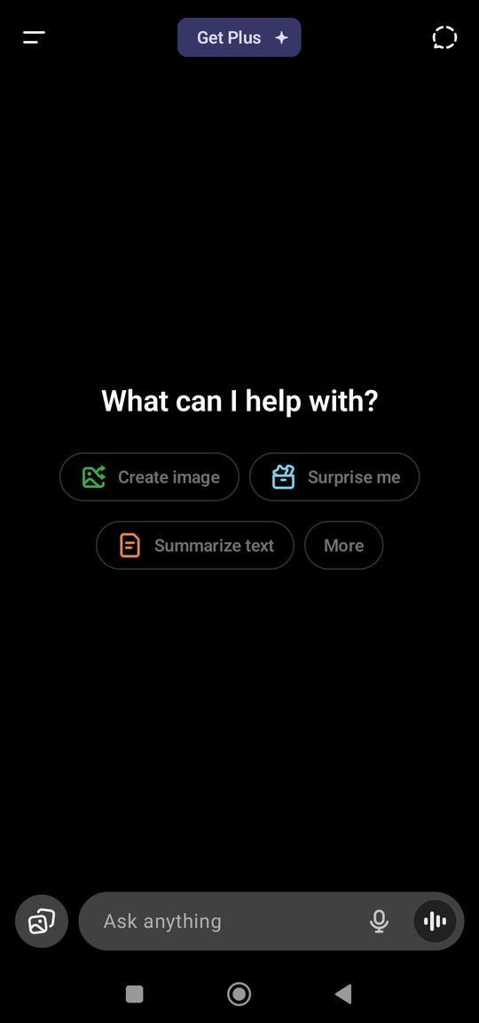



Milestone 1
Increase the Voice input on the ChatGPT Mobile App
Batch 39 - Dipak Nandeshwar
next slide

Slide 2





India’s Voice-Tech Landscape & Mobile Usage Trends
Market Analysis
Expanding Mobile Internet Penetration
Over 55.3% of India’s population approx. 806 million people access the internet via mobile devices (out of a total population of 1.46 billion).
Mainstream Voice Feature Adoption
Nearly 65% (about 524 million people) use voice search, highlighting the convenience and growing preference for hands-free interaction.
Youth and Early Adoption
Over 60% of Gen Z regularly use voice input for search and note-taking, positioning them as a key driver of ongoing growth and innovation.
.
Growth Drivers
Explosive Growth: Voice recognition market projected to grow from $462.8M (2024) to $2.98B (2033) at a 23% CAGR
Mobile-First Nation:
1.12B mobile connections
806M internet users (majority mobile)
Rural smartphone adoption growing
Voice Usage Trends:
76% are familiar with voice tech
Hindi usage in Google Assistant is 2× global average
WhatsApp voice notes, Alexa adoption, and voice search surging
Voice search growing at 270% YoY
.
MAINSTREAM VOICE TECH ADOPTION
ADDRESSABLE CHALLENGES
WHY IT MATTERS
Google Assistant: Hugely popular; more than 50% of users interact using Hindi or other regional languages. Commonly used for searching, setting reminders, and general queries.
YouTube Voice Search: Widely used, especially in Tier 2/3 cities for vernacular content. Voice search accounts for a significant share of YouTube queries in India.
WhatsApp Voice Notes: Heavily utilized for messaging in local languages, favored for ease in noisy environments or when typing is inconvenient.
Voice often trusted for search and casual tasks, but less for productivity or formal input.
Uptake limited by inconsistent accuracy, low discoverability, and lack of onboarding.
Language support and clear prompts are critical for large-scale adoption.
India is
Voice-ready
Multilingual
Mobile-first and
Culturally aligned with spoken interfaces.
next slide

Slide 3

ChatGPT Mobile UX vs. Voice-First Apps
ChatGPT Mobile Voice Input Analysis
Comparison of GPT with other voice first apps
Where is it surfaced?
The mic icon/fire icon is present, but only displays after clicking in the text box resulting in low discoverability.
No onboarding, contextual tips, or language-selection options within voice flow.
User Journey Issues:
Voice input is single-turn; users need to repeatedly tap to speak.
Voice rarely personalized; defaults to English with minimal regional adaptation.
App store reviews mention lack of awareness about the feature, requests for more languages, and unreliable recognition.
FEATURE | Chatgpt | Google Assistant | Whatsapp | Apple Siri | Youtube
Multilingual Support | Medium (improving, Hindi +) | Extensive (20+ Indian languages) | Native (device language) | Medium (regional Indian languages growing) | High (search in vernacular)
Discoverability | Low (mic icon after chat start) | Very High (always on/Hey Google) | Extremely High (UI button) | High (Hey Siri) | Very High (shown next to search)
Ease of Use | Medium | High | High | High | High
Voice Interaction Model | Single-turn | Multi-turn, proactivity | Asynchronous (messages/notes) | Multi-turn | Single-turn (search only)
Onboarding /Guidance | None (no tutorial) | Present | None (very intuitive) | Present | None
Personalization | Limited | High (recognizes voice, learns routines) | None (content only) | Medium | Account-based suggestions
Context Awareness | Moderate | High | Medium | Medium | None
Offline Support | Limited | Partial | Partial | None | Yes (local storage)
UX Gaps to Address
Lack of proactive prompts or guides for discovering voice features.
No personalization (language, dialect, accent adaptation).
No feedback loop (user reminders or prompts to continue using voice).
next slide

Slide 4
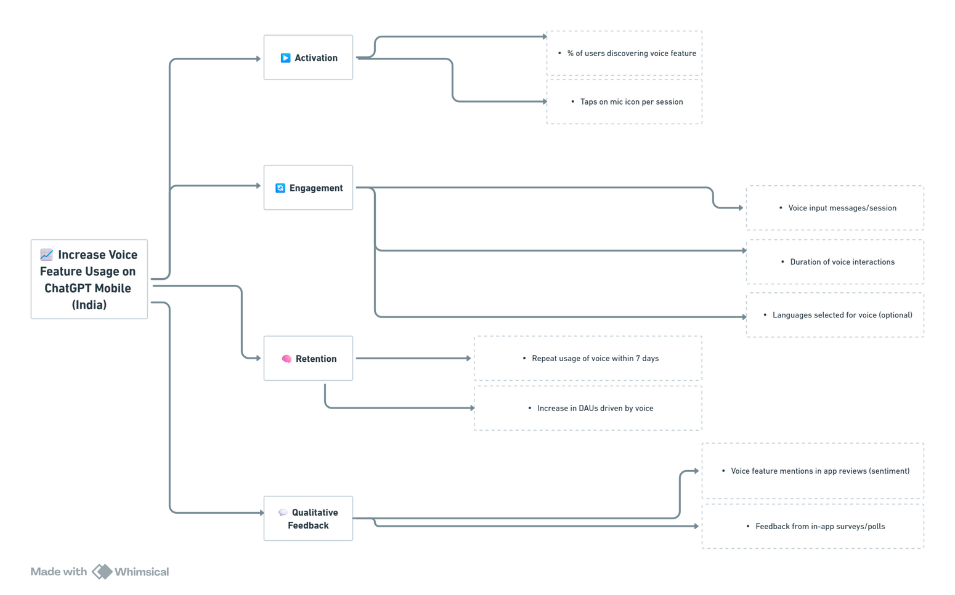
Mapping product outcome to the business outcome
Why Voice Matters for ChatGPT India:
🌍 Access + Inclusivity: Voice bridges gap for new internet users (especially non-English speakers, elderly)
⏱️ Faster Input → Shorter Time-to-Value
🔁 Habit Forming Loop: Introducing voice can make interactions feel more human and habitual
📈 Differentiation: Voice can be a wedge to stand out in India’s AI space
KPI Tree
Product Outcomes
Increased Voice Input Usage Rate
Higher % of sessions with voice interactions
More users initiating chats with voice
Improved Accessibility for Regional & Low-Literacy Users
Growth among users who prefer speaking to typing
Greater adoption across Tier 2/3 cities & rural segments
Higher User Engagement & Session Duration
More time spent per session via voice
Smoother, more conversational user flow
Boost in Retention of Voice-First Users
Higher return rates from voice-preference & non-English users
Business Outcomes
Increase Overall App Engagement
More active users via voice; higher session lengths
Expand Reach to Diverse User Segments
Acquire & retain Tier 2/3, rural, multi-lingual, low-literacy users
Enhance Accessibility & Inclusivity
Lower friction for non-typers; support Indian languages by voice
Strengthen ChatGPT’s Market Position
Compete with Google Assistant, Alexa, WhatsApp; match India’s voice-driven mobile behaviors
next slide

Slide 5
Thank You!
Sources:
HTTPS://WWW.IMARCGROUP.COM/INDIA-VOICE-RECOGNITION-MARKETGRAPH TEXT
HTTPS://WWW.MID-DAY.COM/SUNDAY-MID-DAY/ARTICLE/THE-AI-WILL-SEE-YOU-NOW-23261139
HTTPS://WWW.CNBCTV18.COM/BUSINESS/STARTUP/INDIA-AI-VOICE-TECH-MARKET-ELEVENLABS-19582035.HTM
HTTPS://DATACONOMY.COM/2023/09/05/CHATGPT-INDIA/
HTTPS://OPENAI.COM/INDEX/CHATGPT/?GSID=9C652B2A-DC0A-4DA3-B0D0-99CCA91593AF
HTTPS://TECHNBRAINSPAGE.HASHNODE.DEV/VOICE-FIRST-MOBILE-APPS-REVOLUTIONIZING-USER-INTERACTION

